Slide 1

MOBILE PHONE USAGE IN YOUNGER GENERATION
Statistics data analysis

Slide 2
INTRODUCTION
The use of mobile phones has become an integral part of everyday life.
Young people in particular can be observed using their smartphones constantly.
In this study our aim is to describe and analyze a possible case of smartphone addiction.
TARGET GROUP:
20 to 30 year olds.

Slide 3
What is smartphone addiction?
While a smartphone, tablet, or computer can be a hugely productive tool, compulsive use of these devices can interfere with work, school, and relationships. When you spend more time on social media or playing games than you do interacting with real people, or you can’t stop yourself from repeatedly checking texts, emails, or apps—even when it has negative consequences in your life—it may be time to reassess your technology use.
Smartphone addiction, sometimes colloquially known as “nomophobia” (fear of being without a mobile phone), is often fueled by an internet overuse problem or internet addiction disorder. After all, it's rarely the phone or tablet itself that creates the compulsion, but rather the games, apps, and online worlds it connects us to..

Slide 4
Data Analysis
We carried out a survey and gathered some information regarding our generation's use of mobile phones. The data primarily included ages 20 to 44.
Here are the survey's results after receiving several responses.

Slide 5
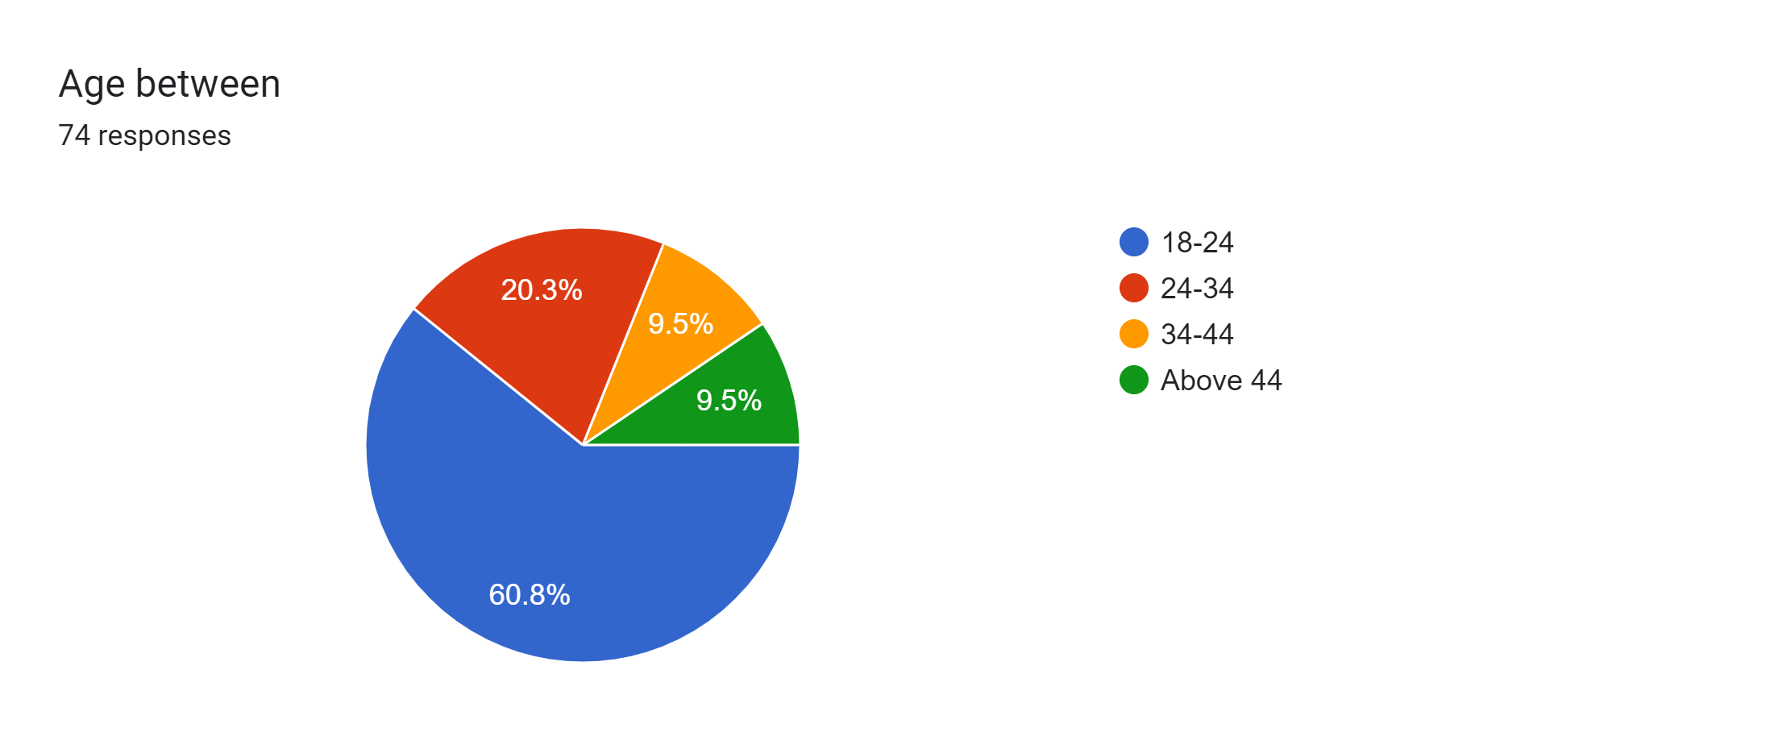
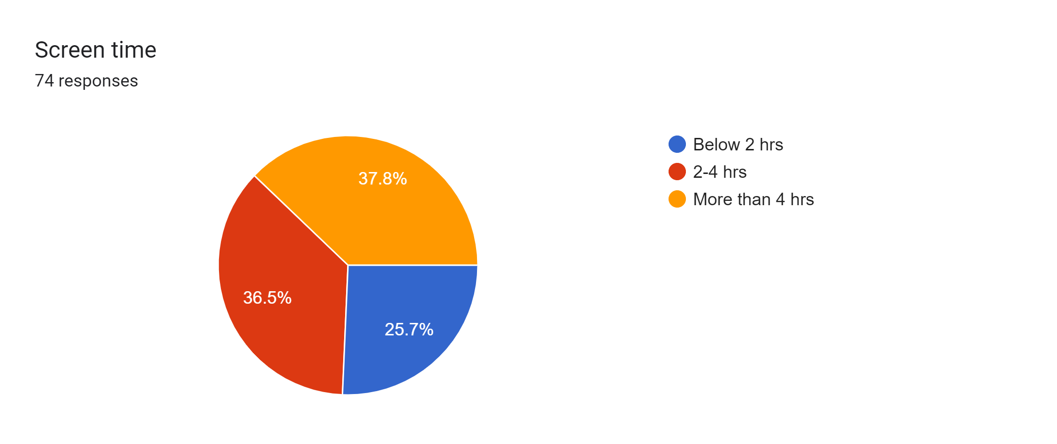

Slide 6
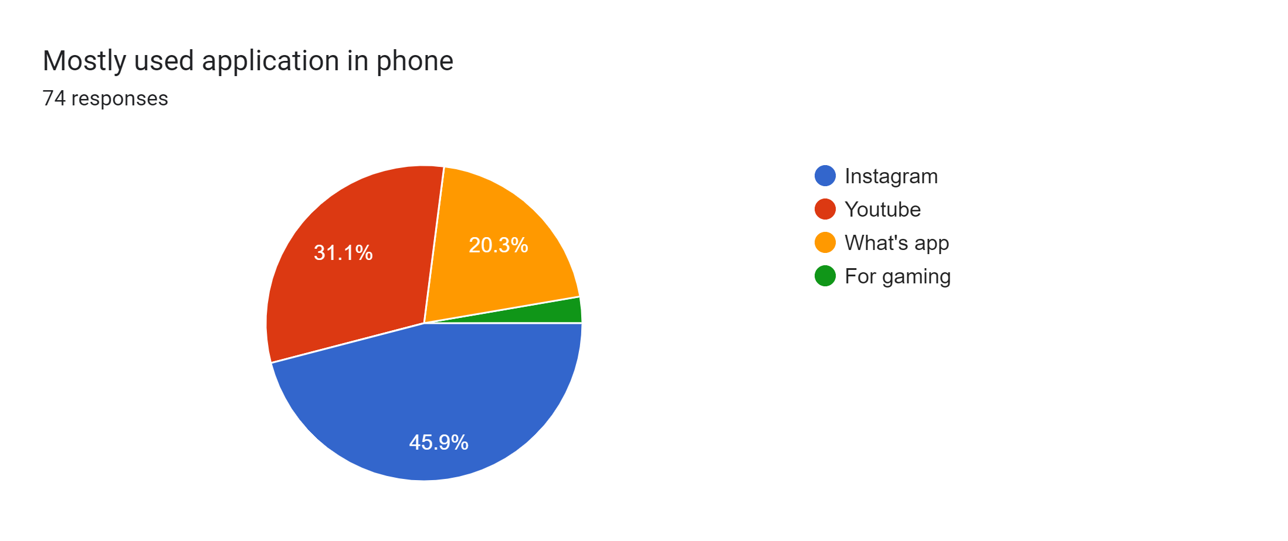
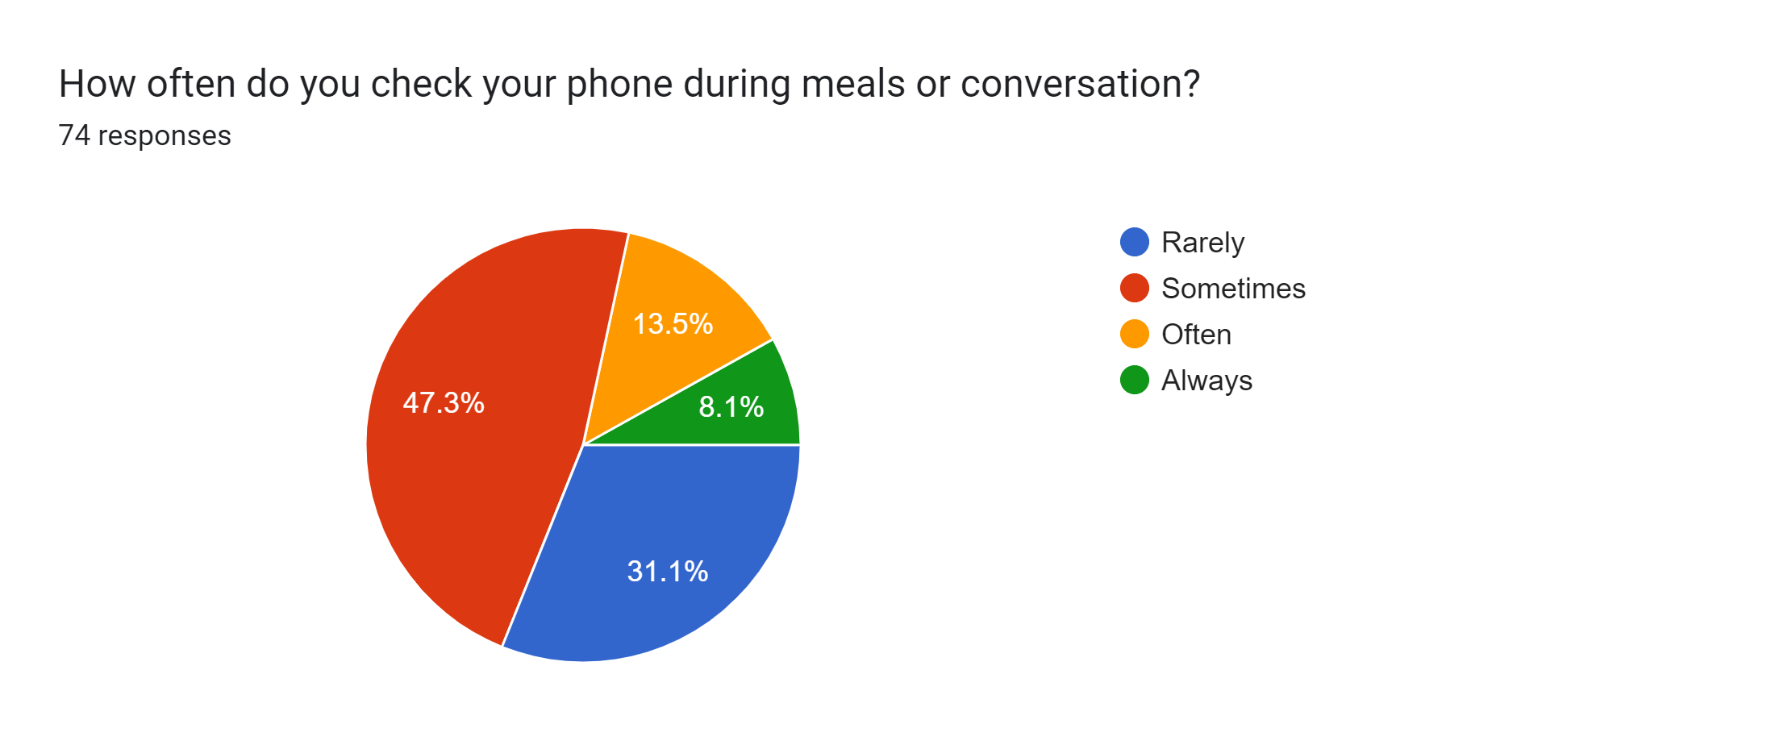

Slide 7
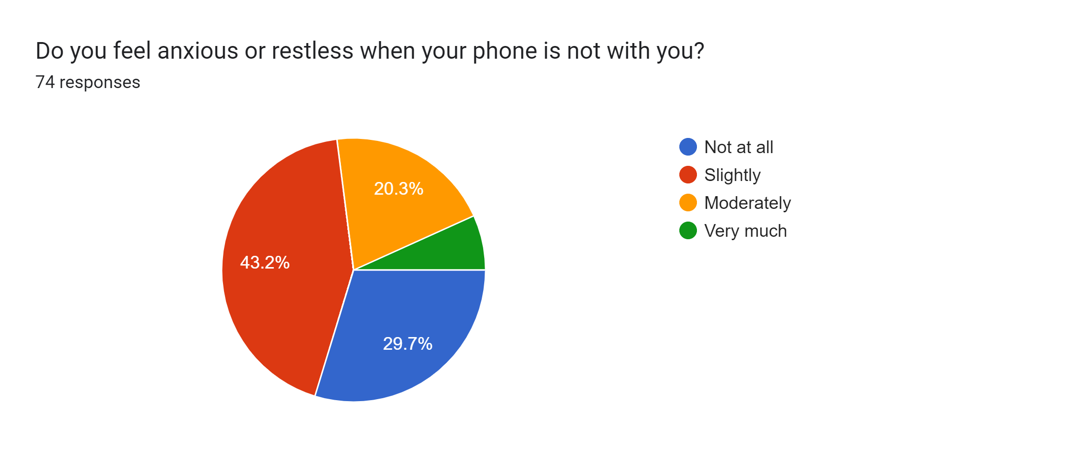

Slide 8
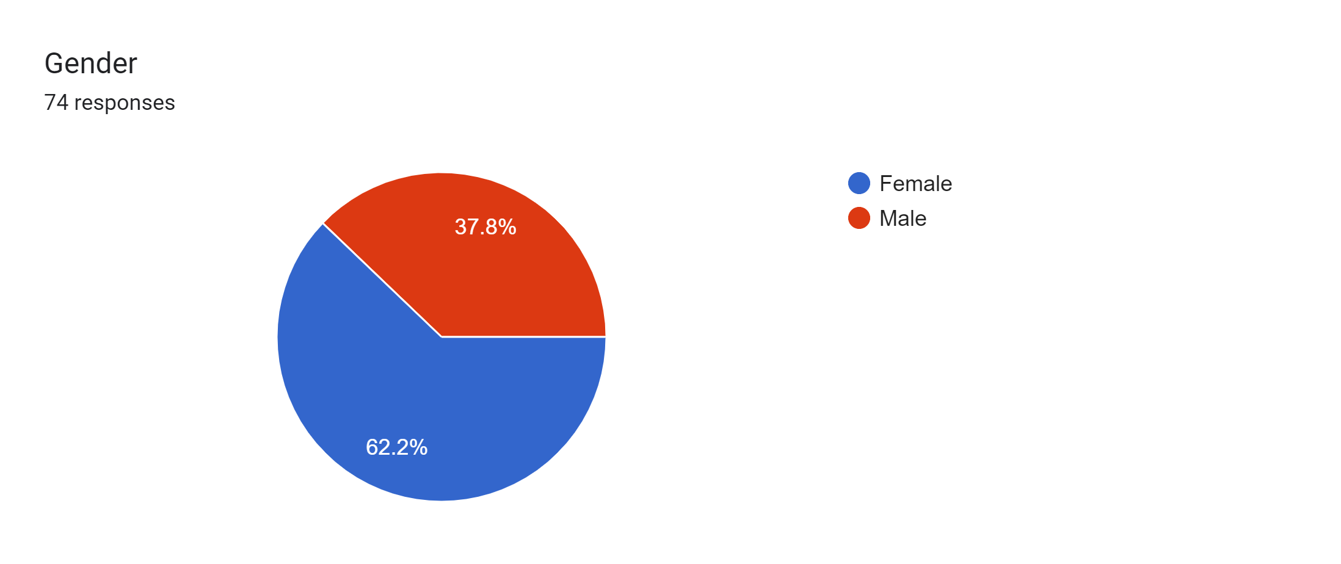


Slide 9
OBSERVATIONS
Based on the provided survey data, here are some conclusions that can be drawn:
1.Age and Screen Time:
Most respondents are in the 18-24 age group.
A significant portion of respondents (across various age groups) reported using their phones for more than 4 hours a day.
2.Mostly Used Applications:
Instagram and YouTube are the most commonly used applications, with WhatsApp and gaming apps also being popular.
3.Checking Phones During Meals or Conversations:
A majority of respondents reported checking their phones during meals or conversations, with some doing so frequently ("Always" or "Often").

Slide 10
4.Anxiety and Restlessness:
Many respondents indicated feeling anxious or restless when their phone is not with them. This suggests a strong dependency on their devices.
5.Gender and Occupation:
The majority of respondents are female.
A mix of students and working individuals participated in the survey.
6.Differences in App Usage and Dependency:
Instagram appears to be a commonly used app across various age groups.
WhatsApp is less frequently used, especially among those aged 24-34 and above.
YouTube is also popular across age groups.

Slide 11
7.Age and Checking Habits:
Younger age groups (18-24) tend to check their phones more often during meals or conversations.
8.Gender and Anxiety:
More females seem to feel anxious or restless when their phones are not with them compared to males.
9.Occupation and App Usage:
Working individuals seem to use WhatsApp more frequently compared to students.
Students are more likely to use Instagram and gaming apps.
10.Age and Occupation:
The 18-24 age group consists mainly of students, while the 24-34 and above age groups have a mix of working individuals and students.

Slide 12
CONCLUSION
These conclusions suggest that there is a significant reliance on smartphones,
particularly among younger individuals, and social media platforms like
Instagram and YouTube are commonly used. The survey also highlights
the potential impact of phone use on social interactions,
with many people checking their phones during meals or conversations. Additionally, it's worth noting that females and working individuals may experience more anxiety when separated from their phones.

